Slide 1

Summer Internship PGDM 2025-27
Topic: Analysis of Purchase of Raw Materials, Production, Sales of Kamdhenu NXT TMT Bars and its Financial Operations
Company Name: Hindupur Steel & Alloys (P) Ltd.
Duration: 1stApril – 31st May 2026 (8 Weeks)
Industry Guide: Mr. Pradip Kumbhakar – General Manager
Faculty Guide: Dr. Chithra S
Name: K. Mohammed Abdulla Khan
Roll. No: 2511421

Slide 2
Introduction
This internship was undertaken at Hindupur Steel & Alloys (P) Ltd., a Kamdhenu franchisee manufacturing TMT bars, from April to May 2026 for 8 weeks. The training provided end-to-end exposure across Quality Control, Production, Billing, Accounts, Finance, and Operations, bridging theoretical management concepts with practical industrial application. Industry Guides:1. Mr. Pradip Kumbhakar – General Manager.
2. Mr. Susheel Kumar Chauhan – Head, Quality Control.
Faculty Guide: Dr. Chithra S

Slide 3
Company Profile
Incorporated: 2009
Type: Private Limited
Location: APIIC Industrial Park, Hindupur, Andhra Pradesh
Products: MS Billets & Kamdhenu NXT TMT Bars
Strength: ~250-300 employees
Turnover: ₹750-1000 Cr
Capacity: ~1,00,000 MT per annum
Owners: 1. Mr. Ganesh Kumar Agarwal – MD
2. Mr. Nithin Kumar Agarwal

Slide 4
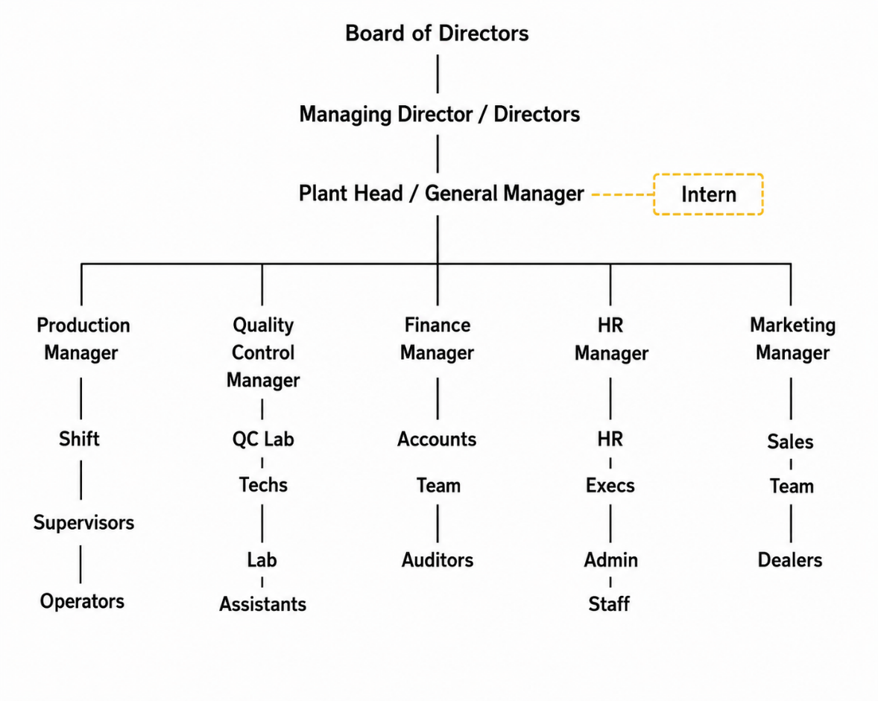
Organisational Structure
Functional Organizational Structure
Production Department
Quality Control Department
Finance & Accounts Department
Human Resources Department
Marketing & Sales Department

Slide 5
Product Portfolio
MS Billets: Semi-finished products for re-rolling mills (100-130mm)
Kamdhenu NXT TMT Bars: IS 1786:2008 Certified | Grades Fe-550D | Sizes 8mm-32mm
Applications: Residential buildings, bridges, dams, flyovers
Key Features: High strength | Ductility | Corrosion resistance | Weldability

Slide 6
Industry Analysis
Brief Profile of the Industry India is the world’s 2nd largest steel producer and a key contributor to GDP, employment, and infrastructure growth. The industry is supported by strong domestic demand, government initiatives, and abundant raw material availability. TMT bars play a major role in construction and infrastructure development.
Present Industry Status The steel industry is growing due to infrastructure projects, rising construction demand, and urbanization. Major trends include increasing TMT consumption, fluctuating raw material costs, energy challenges, and stricter quality standards.
Future Prospects of the Industry The industry has strong growth potential with India targeting 300 MT steel capacity by 2030–31. Urbanization, infrastructure investment, export opportunities, and green steel initiatives will continue driving future demand.

Slide 7
Competitors
Competitor | Key Products
Tata Steel | TMT Bars, Structurals
JSW Steel | TMT Bars, Billets
SAIL | TMT Bars, Billets
JSPL | TMT Bars, Billets
Vizag Steel (RINL) | TMT Bars, Wire Rods
Competitive Advantage: Kamdhenu brand recognition + Proximity to South Indian markets + Cost-efficient scrap-based production

Slide 8
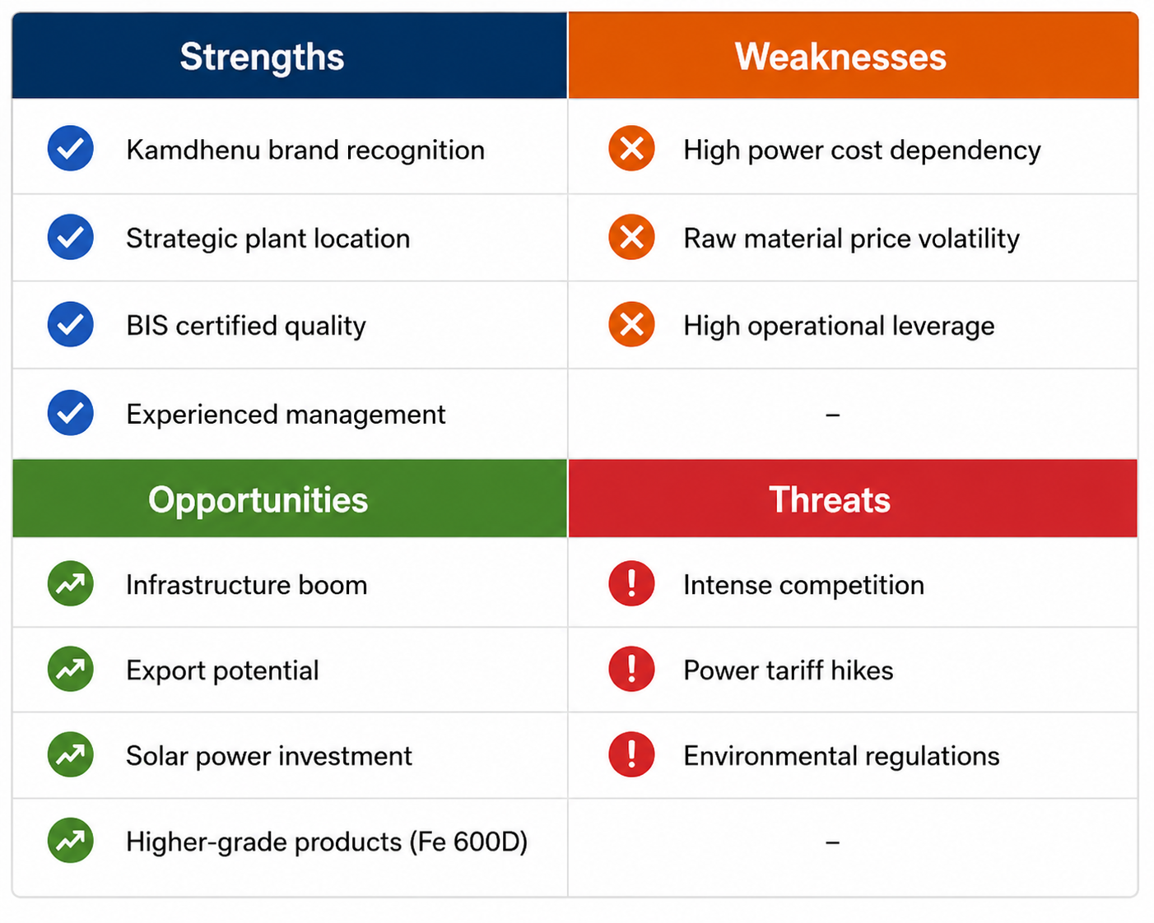
SWOT Analysis

Slide 9
Work Assigned
Weeks | Department | Key Activities
1-2 | Quality control and production | Tensile testing, Ring Test, Spectro
3-4 | Billing & Accounts | Invoice generation, Tally, Ledgers
5-6 | Finance & Cost Analysis | Purchase/sales data, operational costs
7-8 | Production & Operations | Profitability analysis,breakeven

Slide 10
Role & Responsibilities
Conducted tensile testing every 30 minutes
Performed Ring Test (Etching Test) for microstructure verification
Analyzed raw material composition using Spectro Lab
Generated invoices and maintained ledgers in Tally
Analyzed purchase, sales, and operational cost data
Created Excel charts for profitability tracking
Calculated KPIs, yields, and breakeven point

Slide 11
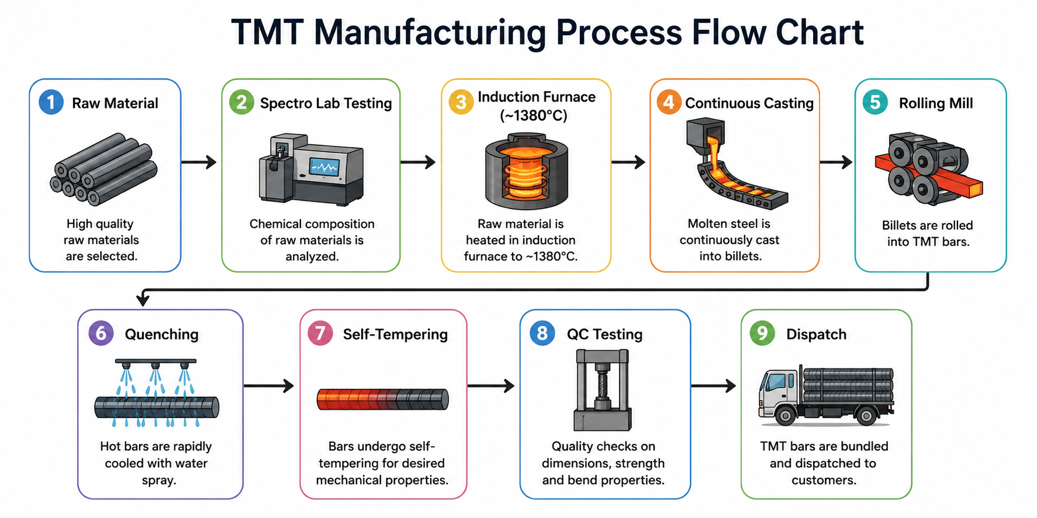
Process Followed – TMT Manf.

Slide 12
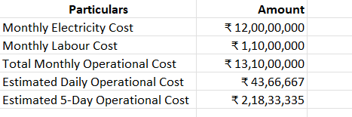
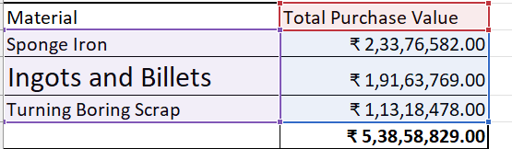
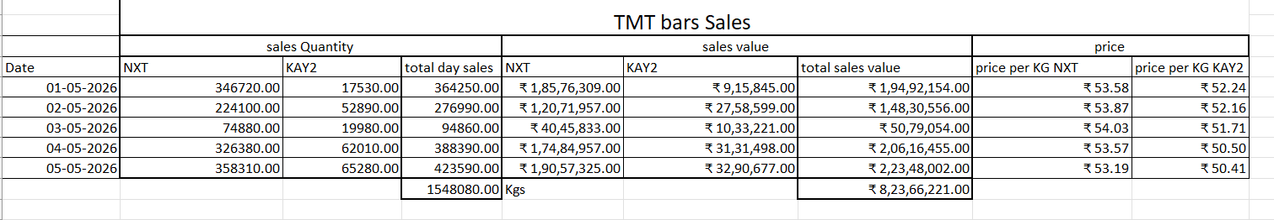
Sales, purchase and operational Data

Slide 13

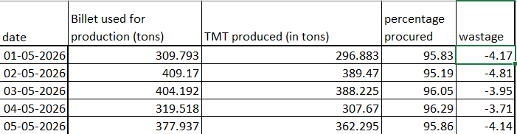
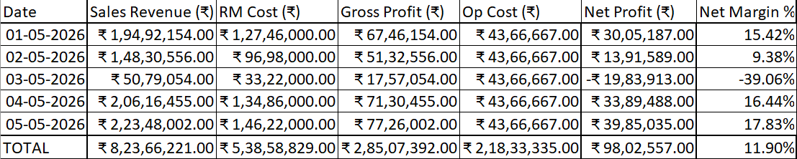
Production yield and profit analysis

Slide 14
Results Achieved
Metric | Value
Total Sales Quantity | 1,548 Tons
Average Selling Price | ₹53,205 / Ton
Average Variable Cost | ₹34,791 / Ton
Daily Breakeven Quantity | 237 Tons
Daily Breakeven Revenue | ₹1.26 Crore
Stage | Yield
RM → Billet | 83.9%
Billet → TMT | 95.8%
Brand | Volume Share | Selling Price
Kamdhenu NXT | 86% | ₹53.55/kg
KAY2 | 14% | ₹51.13/kg

Slide 15
Learnings
Technical
Complete TMT manufacturing process
Quality control (Tensile, Ring Test, Spectro Lab)
IS 1786:2008 & IS 1893:2025 standards
Industry cost structures & breakeven analysis
Software
Tally (basic proficiency)
Excel charts & data analysis
Soft Skills
Cross-functional communication
Professional documentation
Problem-solving

Slide 16
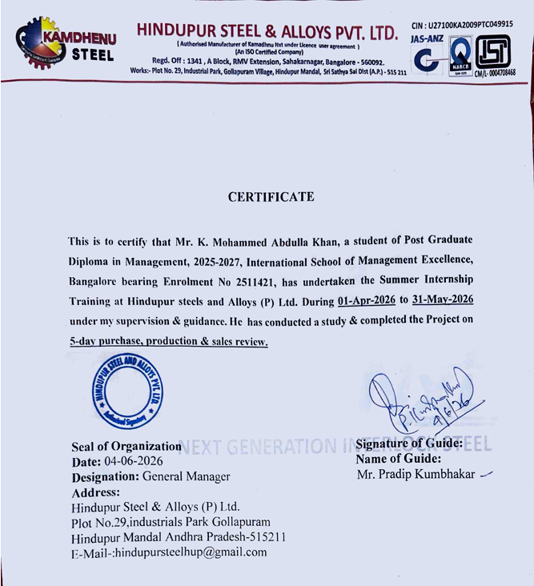
Certificate from the company

Slide 17
Feedback from the company
Yet to receive

Slide 18
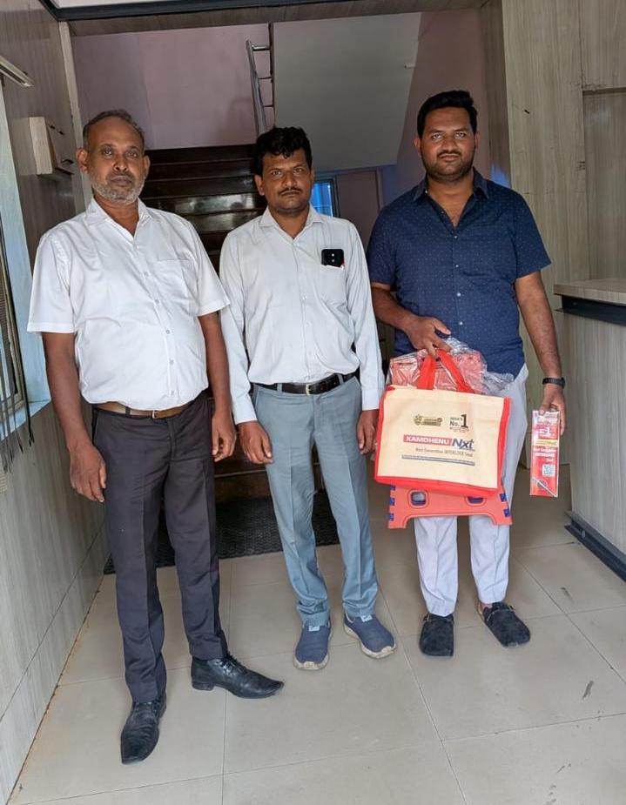
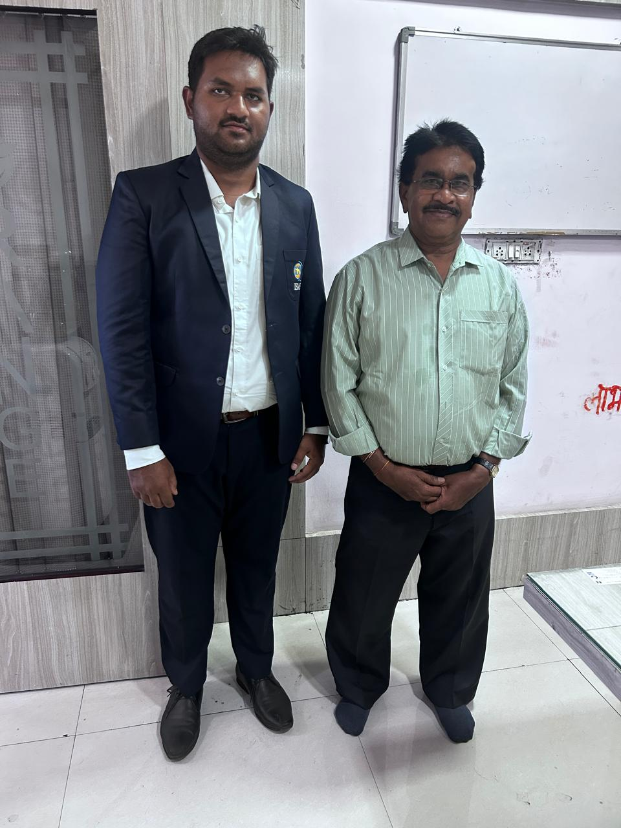

Slide 19
THANK YOU

